Slide 1

Final Review

Slide 2
Outline
Mock Exam
Final Exam
Mock Exam Results
Question and Chapter Review
Wrapup

Slide 3
Mock Exam
Is it a joke???
What is it?
Lectures, piazza
http://wiki.komica.org/pix/img1647.jpg

Slide 4
WIFI, Google forms, online test…
Never feel so ‘good’ with them while the exam…
https://copyhackers.com/wp-content/uploads/2012/11/disappointed-bear.jpg

Slide 5
Number of Questions

Slide 6
Hard v.s Easy

Slide 7
What are we going to do in the final
It will be a closed book and paper-based exam.
What does it mean?
Traditional exam, questions + one page answer sheet, all are multiple choice questions
No mobiles/tablets/computers
No textbook, No helping others
Self-written notes are allowed.

Slide 8
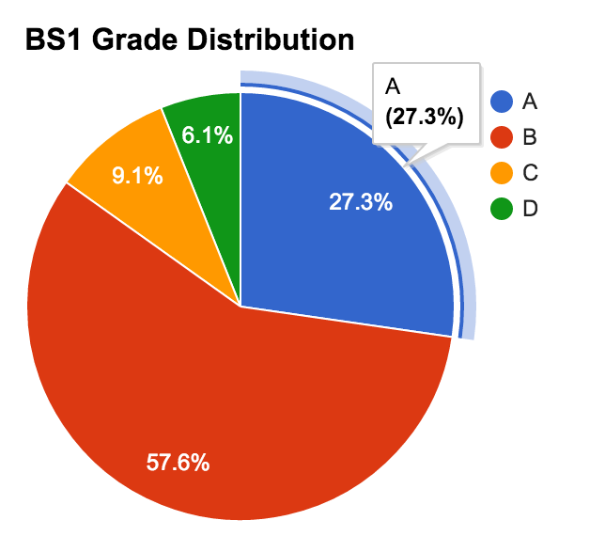
Mock Exam Results – BS1
Andrey Kulagin
BS1#3

Slide 9
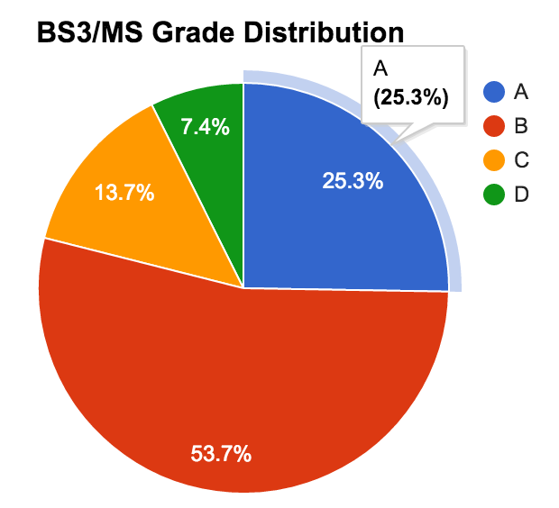
Mock Exam Results – BS3+MS
Andrey Lebedev
BS3#4

Slide 10
Please help, I didn't submit mock exam…
Let’s work on the final
If you succeed the final, we will grant you full mark of the mock exam
What is the standard of success?
If you get more than 75% questions right in the final

Slide 11
Quick review So, what we learnt ?

Slide 12
To be concise
How to model data and how to use databases
Intro-w1, ER-w2, relational models-w3, sql-w4,constraints & triggers-w5, relational design theory (fd-w6, nf-w7), schema/psm-w8,
How to build databases: internals
File, hashing and external sorting-w9, indexing-w10, query evaluation and optimization-w11, transaction-w13

Slide 13
Why use a DBMS? (W1)
Avoid redundancy and inconsistency
Rich (declarative) access to the data
Synchronize concurrent data access
Recovery after system failures
Security and privacy
…
13

Slide 14
Application
SQL
{tuples}
Server (Network, App Buffers, Security)
Query Processor
Transactions
(Locking, Logging)
Data Manager (Indexes, Records)
Catalog Mgmt
(Schema, Stats)
Storage Manager (Pages)
get/put
block
Storage System (disks, SSDs, SAN, …)

Slide 15
How to model data and use db

Slide 16
requires
ER! UML?
Follow-up
LecID
StuID
prerequisite
N
M
attends
CP
Name
Student
Lecture
N
M
N
N
Semester
M
Title
tests
gives
Grade
ResID
1
Level
1
works-with
Name
Researchers
Professor
Room
N
1
Area
ProfID
Name
16

Slide 17
AddrBook
Name | Street | Tel#
Mickey Mouse | Main Street | 4711
Minnie Mouse | Broadway | 94725
Donald Duck | Broadway | 95672
... | ... | ...
Relational data model
Instance: the state of the database
Key: minimal set of attributes that identify each tuple uniquely
E.g., {Tel#} or {Name, BirthDate}
Primary Key: (marked in schema by underlining)
select one key, use primary key for references
How to map ER to RDM?
17

Slide 18
Relational Algebra & SQL (structured query language)
RA operators: selection, Cartesian product, joins, etc.
SQL History
A family of standards
Data definition language (DDL) - schemas
Data manipulation language (DML) - updates
Query language (Query) – reads
DDL: data types; DML/Query: joins, grouping, exist, subqueries, views
18

Slide 19
Integrity of Data (Constraints and Triggers)
Example Constraints
Keys
attribute domains
Referential integrity (foreign keys -> keys)
...
Static Constraints
Constraints that any instance of a DB must meet
Dynamic Constraints
Constraints on a state transition of the DB
19

Slide 20
Functional Dependencies
X -> A
whenever two tuples of R agree on all the attributes of X, then they must also agree on the attribute A.
name addr beersLiked manf favBeer
Janeway Voyager Bud A.B. WickedAle
Janeway Voyager WickedAle Pete’s WickedAle
Spock Enterprise Bud A.B. Bud
Because name -> addr
Because name -> favBeer
Because beersLiked -> manf

Slide 21
Keys of Relations- what are they and how to compute?
K is a superkey for relation R
if K functionally determines all of R.
K is a key for R
if K is a superkey, but no proper subset of K is a superkey.

Slide 22
A relation STUDENT is with 5 attributes {first name, last name, address, date of birth, hobby}. If FD’s on STUDENT are
{last name, address}-> date of birth,
{first name, last name, date of birth}-> address,
{address, date of birth}->hobby,
then we have the key of STUDENT:
A. first name, last name
B. first name, last name, address
C. first name, last name, address, date of birth
D. first name, last name, date of birth
E. first name, last name, address, hobby

Slide 23
Relational Schema Design: normal forms
Goals of relational schema design ?
What are the following concepts?
1NF, 2NF, 3NF, BCNF
How to decompose a relation into a specified NF? If given specified relations, how to judge which normal form it follows?

Slide 24
Normal Forms-summary – Why?
If all attributes are key attributes, then the design at least meets 3NF (in 3NF, A must be a non-key attribute).
If all keys are singleton, then the design at least meets 2NF (in 2NF, X must be a proper subset of a key).
3NF implies 2NF
BCNF implies 3NF
Preserving dependencies up to 3NF

Slide 25
Select all the incorrect statements
A. If a design are key attributes, then the design at least meets 3NF
B. If all keys are singleton, then the design at least meets 3NF
C. Preserving dependencies up to 3NF
D. If a view involves only one base relation, the view is updatable.

Slide 26
DB Schema and PSM
What is schema? Why normalization? What is denormalization?
OLTP v.s OLAP, what are the characteristics of the two
What is PSM? Why PSM? What are the differences between PSM and programming languages/triggers/cursors?

Slide 27
How to build DB: DB internals

Slide 28
File, hash, external sorting
What are the properties of disks? What are caching? What are files? What is I/O scheduler? What is buffer manager? Why buffer management and how?
Hashing v.s extendible hashing v.s linear hashing
Why sorting? And how?

Slide 29
____ is a unit of storage that can store one or more records in a hash file organization.
A. Nodes.
B. Blocks.
C. Buckets.
D. Disk pages.

Slide 30
Indexing
Why indexes?
What are ISAM, B-tree, and B+-tree
How to organize indexes? And why?
Tree v.s hashing?

Slide 31
Query evaluation and optimization
What is cost-based subquery system (v.s. rule-based?)? Architecture?
What is catalog manager? And why?
Query plan? What are the operator evaluation strategies? Algorithms? (file scan? Blocked nested loops? Sort merge join?)
Hashing v.s sorting?

Slide 32
Transaction
Why transaction?
What are the correctness criteria? ACID?
How to control concurrency?
How to recover in case of failures?

Slide 33
Recovery system guarantees:
A. Consistency
B. Atomicity
C. Isolation
D. Durability

Slide 34
Thank you all !
Congratulations to your first completed Dainfos course!
Keep calm and work hard!
Dainfos Lab is welcoming your visit and join!

